Slide 1
IMPLEMEMENTATION OF CLOAKING WALL MODEL WITH LEAKAGE - SUPPRESSED AND LIGHT WEIGHT ACCESS CONTROL FOR CLOUD DATA STORAGE

Slide 2
Problem Statement
Ensuring data privacy, integrity, and compliance with industry regulations.
Limited scalability and flexibility for accommodating growing storage needs.
Prone to misconfigurations, leading to security risks.
Time-consuming data transfer impacting system performance.
Inadequate monitoring leading to suboptimal performance.

Slide 3
Aim and Objectives
Aim:
The aim of the project is to establish an advanced cloud data security framework by designing a Cloaking Wall Model integrated with camouflage techniques. This framework seeks to enhance privacy and access control for sensitive data stored in cloud environments.
Objectives
To design and conceptualize the components of the Cloaking Wall Model
To Integrate Camouflage Techniques
To design and implement access control mechanisms
To implement leakage-suppressed techniques
To minimize the computational overhead associated with access control operations.

Slide 4
Abstract
Cloud computing transforms organizational operations with on-demand resource access.
Cross-organization data sharing faces challenges requiring agreement on data processing.
Primary concern in information security and cloud computing.
Focus on developing Cloaking Wall Model for cloud storage. Four methods: Long-Term, Multi-Region, Time-based, and Geolocation-based Cloaking.
Cloaking identifies user types, ensuring content distribution to the right target. The Camouflage Data Disguise technique enhances security, using Chaffing and Winnowing with ChaCha20 encryption, distributing disguised data selectively.
Methods fortify data security with confidentiality, global consistency, and timed access.

Slide 5
Introduction
In cloud computing, where seamless accessibility coexists with concerns about data protection, the Cloaking Wall introduces a robust protective barrier.
This methodology is designed to safeguard sensitive information stored in the cloud by concealing access patterns and fortifying the mechanisms governing data interactions.
This methods contributes a unique layer of defense, collectively establishing a fortified shield around cloud-stored data.
The Camouflage Data Disguise technique represents an advanced cryptographic approach that seamlessly integrates Chaffing and Winnowing with the formidable ChaCha20 encryption algorithm.

Slide 6
Existing System
Encryption Techniques:
Utilization of encryption algorithms to protect data in transit and at rest.
Common encryption methods include AES (Advanced Encryption Standard) and RSA (Rivest-Shamir-Adleman).
Access Controls and Identity Management:
Implementation of access control mechanisms to regulate user permissions.
Identity and access management solutions ensure only authorized users have access to sensitive data.
Intrusion Detection and Prevention Systems (IDPS):
Utilization of IDPS to detect and respond to potential security threats.
Helps in real-time monitoring and protection against malicious activities.

Slide 7
Disadvantages
Encryption complexity may impact system performance.
Traditional authentication methods may be vulnerable to attacks.
Relying on cloud providers' security exposes risks.
Human-related risks persist despite security training.
Firewalls may not cover all sophisticated attack vectors.

Slide 8
Proposed System
The proposed system endeavors to revolutionize cloud data security by introducing a sophisticated Cloaking Wall Model specifically designed to safeguard organizational operations in the ever-evolving landscape of cloud computing.
Long-Term Cloaking:
This method focuses on providing extended protection for sensitive data over prolonged durations. It involves concealing access patterns and data usage trends over an extended timeframe, ensuring persistent confidentiality.
Multi-Region Based Cloaking:
Recognizing the global nature of cloud services, multi-region-based cloaking involves implementing security measures that transcend geographical boundaries.

Slide 9
Proposed System
Time-Based Cloaking:
Time-based cloaking introduces temporal restrictions on data access, allowing organizations to define specific time windows during which data can be accessed.
Geolocation-Based Cloaking:
Geolocation-based cloaking involves tailoring data protection measures based on the geographical location of users.

Slide 10
Proposed System
Conditional Disguise
Disguise data selectively based on specific conditions or user roles. The Camouflage Data Disguise Generator module, integrating Chaffing and Winnowing with the robust ChaCha20 encryption algorithm, is strategically designed to elevate the security and privacy of data.
Chaffing and Camouflage Process
Chaffing, which adds decoy or chaff data, and Camouflage, which further disguises non-compliant data through additional obfuscation techniques.
ChaCha20 Encryption
Genuine, chaff, and camouflaged data undergo encryption using the ChaCha20 algorithm.
Winnowing Process
At the recipient's end, the winnowing process disentangles the genuine data from the chaff and camouflage layers. The ChaCha20 decryption algorithm, combined with the appropriate key, unveils the original, non-compliant data.

Slide 11
Advantages
Integrates advanced security measures for comprehensive data protection.
Ensures data confidentiality at rest, in transit, and during processing.
Reduces administrative workloads through efficient certificate management.
Enhances security through defined time windows for data access.
No encryption standards

Slide 12
System Requirements
Hardware Requirements
Processors : Intel® Core™ i5 processor,8 GB of Ram
DRAMDisk space : 320 GB
Operating systems : Windows® 10, macOS*, and Linux*
Software Requirements
Server Side : Python 3.7.4(64-bit) or (32-bit)
Client Side : HTML, CSS, Bootstrap
IDE : Flask 1.1.1
Back end : MySQL 5.
Server : Wampserver 2i

Slide 13

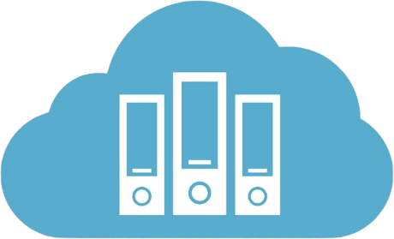


System Architecture
Login
Cloaking Wall Model
Upload Data
Long Term Cloaking
Add and Manage User
Region based Cloaking
Data Owner
Configure Cloaking Wall
Location based Cloaking
Access Monitoring
Time Based Cloaking
Enterprise Cloud Server
Cloaking Area
Request File
Response File
Bogus File
Request File
Data User
Malicious User

Slide 14
Modules
Cloud Service Provider Web App
End User Interface
Cloaking Wall Model
Access Policy Configurator
Bot Identification and Data Distribution
Disguise Data Generator
Monitoring and Auditing
Alerts and Notification

Slide 15
1. Cloud Service Provider
The design and development of a Cloud Consumer Web App using Python, Flask and MySQL and Bootstrap.
The user authentication module serves as the entry point, ensuring secure access through robust registration and authentication processes, including multi-factor authentication for enhanced security.
The dashboard module, at the core of the application, seamlessly integrates the Cloaking Wall Model, providing users with an intuitive interface for cloud resource management while ensuring global consistency in security measures.
The monitoring and alert module is essential for empowering users with real-time insights into the performance of their cloud resources and timely notifications of any irregularities.

Slide 16
2. End User Interface
2.1. Admin or Data Owner Interface
Login Module
The login module provides a secure authentication process for Admins or Data Owners, ensuring only authorized access to the cloud management interface.
Add and Manage Data
Admins can add, organize, and manage data within the cloud storage. This module allows them to upload, categorize, and control access to various datasets.
Add and Manage Users
Admins have the capability to add new users to the system, defining their roles and permissions. This module also allows them to modify or revoke access as needed.

Slide 17
Provide Login Credentials to Users:
Admins can generate and distribute login credentials for users added to the system. This ensures a secure onboarding process for new users.
Set Access Policy using Cloaking Wall Model:
Leveraging the Cloaking Wall Model, this module enables Admins to set access policies. Admins can define Long-Term Cloaking, Multi-Region based Cloaking, Time-based Cloaking, and Geolocation-based Cloaking to enhance data security.
Monitoring Data Access:
Admins can monitor and audit data access patterns using this module. It provides insights into who accessed specific data, when, and from which location, contributing to overall security and compliance.

Slide 18
2.2. Data User Interface
Login Module
Similar to the Admin interface, the login module provides secure authentication for Data Users, ensuring that only authorized individuals can access the cloud resources.
Access Data
Data Users can use this module to access the data allocated to them. The interface provides a user-friendly environment for retrieving, modifying, or analysing data based on their permissions.
Monitoring Data Access
Data Users have limited access to monitoring tools to track their own data access. This module allows them to review their activity and ensures transparency in usage.

Slide 19
3. Cloaking Wall Modules
The Cloaking Wall Model is a security framework integrated into the Cloud Consumer Web App, offering advanced data protection and access control.
3.1. Long-Term Cloaking
The Long-Term Cloaking module ensures persistent confidentiality of data access patterns over extended durations. Admins can set policies to conceal and protect access trends, preventing unauthorized inference from historical usage data.
3.2. Multi-Region Based Cloaking
This module facilitates a unified security approach across diverse geographical regions. Admins can define access controls that transcend geographic boundaries, ensuring consistent security measures globally and addressing challenges related to multi-region data access.

Slide 20
3.3. Time-Based Cloaking
Time-Based Cloaking empowers Admins to set temporal restrictions on data access. This module enhances security by allowing the definition of specific time windows during which data can be accessed, adding an extra layer of control over temporal access patterns.
3.4. Geolocation-Based Cloaking
The Geolocation-Based Cloaking module tailor’s data protection based on user location. Admins can define security policies that vary depending on the physical location of Data Users, adding a location-sensitive layer to access controls.

Slide 21
4. Access Policy Configurator
The Access Policy Configuration module is to define and customize access policies for the Cloud Consumer Web App.
This module plays a crucial role in tailoring the security measures based on Long-Term Cloaking, Multi-Region based Cloaking, Time-Based Cloaking, and Geolocation-Based Cloaking principles.
This module provides a centralized dashboard for administrators to configure comprehensive access policies.
They can set parameters, thresholds, and exceptions to align with the security requirements of the organization.

Slide 22
5. Bot Identification and Data Distribution
The Bot Identification Mechanism within the Cloaking Wall Model ensures that automated bots attempting to access the data in violation of access policies are promptly identified.
This module ensures that benign content is delivered to authentic users, while malicious content is selectively distributed to identified bots
Policy Adherence Assessment
Each user, including potential bots, is assessed against the defined access policies. Legitimate Data Users are expected to follow the specified Long-Term Cloaking, Multi-Region based Cloaking, Time-Based Cloaking, and Geolocation-Based Cloaking rules. Any entity not adhering to these policies is flagged for further scrutiny.

Slide 23
6. Disguise Data Generator
The Disguise Data Generator Module, tailored for the Injection of Non-Compliant Data specifically targeted at users violating the access policy set by the admin.
Chaffing and Camouflage Process
Chaffing, which adds decoy or chaff data, and Camouflage, which further disguises non-compliant data through additional obfuscation techniques.
ChaCha20 Encryption
Genuine, chaff, and camouflaged data undergo encryption using the ChaCha20 algorithm.
Winnowing Process
At the recipient's end, the winnowing process disentangles the genuine data from the chaff and camouflage layers. The ChaCha20 decryption algorithm, combined with the appropriate key, unveils the original, non-compliant data.

Slide 24
7. Monitoring and Auditing
In real-time, the module monitors and captures a spectrum of activities, including user interactions, data access, and system operations.
It maintains a meticulous log of policy enforcement instances, detailing the invocation of access policies defined by the Cloaking Wall Model, along with outcomes and responses to policy violations.
Furthermore, the module diligently tracks all data access and modification events, providing insights into who accessed specific data and the nature of their interactions, aiding in forensic analysis.

Slide 25
8. Alerts and Notification
Upon detection of a policy violation, the module triggers immediate alerts, swiftly notifying administrators through various channels such as email, SMS, in-app messages, or other preferred communication methods.
These alerts are designed to provide administrators with detailed information about the nature of the policy violation, offering insights into unauthorized access attempts, data modifications beyond permitted levels, or breaches of temporal and geolocation constraints.
This proactive alerting mechanism minimizes the latency between the occurrence of a policy violation and the notification to administrators, facilitating a rapid and targeted response.

Slide 26
Database
CC: Admin Login
S.No | Field | Data Type | Field size | Constraint | Description
1 | username | varchar | 20 | Null | Admin Username
2 | password | varchar | 20 | Null | Admin Password

Slide 27
CC: Data Owner
S.No | Field | Data Type | Field size | Constraint | Description
1 | id | Int(11) | 11 | Primary Key | owner Id
2 | name | Varchar(100) | 100 | Null | Owner Name
3 | city | Varchar(100) | 100 | Null | Owner City
4 | mobile | Bidint(20) | 20 | Null | Owner Mobile
5 | email | Varchar(40) | 40 | Null | owner Email
6 | Owner id | Varchar(20) | 20 | Primary Key | Owner id
7 | password | Varchar(20) | 20 | Null | Owner password
8 | Approved status | Int(11) | 11 | Null | Owner approved status

Slide 28
CC: Data User
S.No | Field | Data Type | Field size | Constraint | Description
1 | id | Int(11) | 11 | Null | Unique Id
2 | Owner id | Varchar(20) | 20 | Foreign key | Owner id
3 | name | Varchar(20) | 20 | Null | user Name
4 | gender | Varchar(20) | 20 | Null | user gender
5 | dob | Varchar(20) | 20 | Null | User dob
6 | mobile | Bidint(20) | 20 | Null | User Mobile
7 | email | Varchar(40) | 40 | Null | user Email
8 | location | Varchar(30) | 30 | null | User location
9 | user id | Varchar(20) | 20 | Primary Key | user id
10 | password | Varchar(20) | 20 | Null | user password

Slide 29
CC: File Uploaded
S.No | Field | Data Type | Field size | Constraint | Description
1 | File id | Int(11) | 11 | Primary Key | File Id
2 | Owner id | Varchar(20) | 20 | Foreign key | Owner id
3 | File description | Varchar(20) | 20 | Null | File description
4 | File path | Varchar(20) | 20 | Null | File path
5 | File size | Varchar(20) | 20 | Null | File size
6 | Upload date | timestamp | null | Null | Upload date

Slide 30
CC: Long Term Wall Model
S.No | Field | Data Type | Field size | Constraint | Description
1 | id | Int(11) | 11 | Primary Key | Unique Id
2 | Owner id | Varchar(20) | 20 | Foreign key | Owner id
3 | User id | Varchar(20) | 20 | Null | User id
4 | File id | Int(11) | 11 | Null | File id
5 | Shared date | timestamp | Null | Null | File shared date

Slide 31
CC: Region Wall Model
S.No | Field | Data Type | Field size | Constraint | Description
1 | id | Int(11) | 11 | Null | Unique Id
2 | Owner id | Varchar(20) | 20 | Foreign key | Owner id
3 | User id | Varchar(20) | 20 | Null | User id
4 | File access location | Varchar(30) | 30 | Null | File access
5 | Geo location path | Varchar(100) | 100 | Null | Geo location date
6 | File id | Int(11) | 11 | Null | File id
7 | Shared date | Time stamp | Null | Null | File share date

Slide 32
CC: Geolocation Wall Model
S.No | Field | Data Type | Field size | Constraint | Description
1 | id | Int(11) | 11 | Null | Unique Id
2 | Owner id | Varchar(20) | 20 | Foreign key | Owner id
3 | User id | Varchar(20) | 20 | Null | User id
4 | region | Varchar(30) | 30 | Null | File access region
5 | Geo location path | Varchar(100) | 100 | Null | Geo location of region
6 | File id | Int(11) | 11 | Null | File id
7 | Shared date | Time stamp | Null | Null | File share date

Slide 33
CC: Time Wall Model
S.No | Field | Data Type | Field size | Constraint | Description
1 | id | Int(11) | 11 | Null | Unique Id
2 | Owner id | Varchar(20) | 20 | Foreign key | Owner id
3 | User id | Varchar(20) | 20 | Null | User id
4 | Start time | Varchar(20) | 20 | Null | Start time
5 | End time | Varchar(20) | 20 | Null | File end time
6 | Access date | Varchar(20) | 20 | Null | File access date
7 | Shared date | Time stamp | Null | Null | File share date

Slide 34
CC: File Access Log
S.No | Field | Data Type | Field size | Constraint | Description
1 | id | Int(11) | 11 | Null | Unique Id
2 | User id | Varchar(20) | 20 | Foreign key | User id
3 | File id | Int(11) | 11 | Null | File id
4 | Date time | timestamp | Null | Null | File shared date

Slide 35
CC: Unauthorised Access Log
S.No | Field | Data Type | Field size | Constraint | Description
1 | id | Int(11) | 11 | Null | Unique Id
2 | User id | Varchar(20) | 20 | Foreign key | User id
3 | Download mode | Varchar(20) | 20 | Null | Download mode id
4 | Download file id | Int(11) | 11 | Null | File downloaded id
5 | Date time | timestamp | Null | Null | File shared date

Slide 36
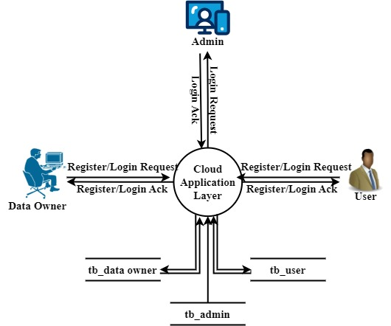
DFD: Level 0

Slide 37
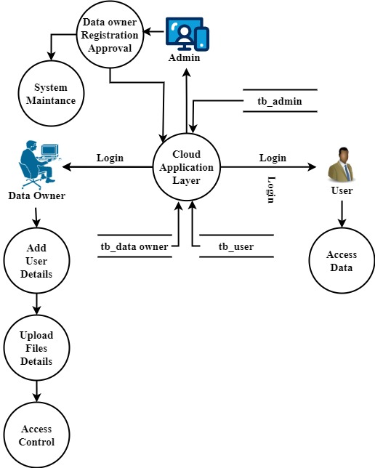
DFD: Level 1

Slide 38
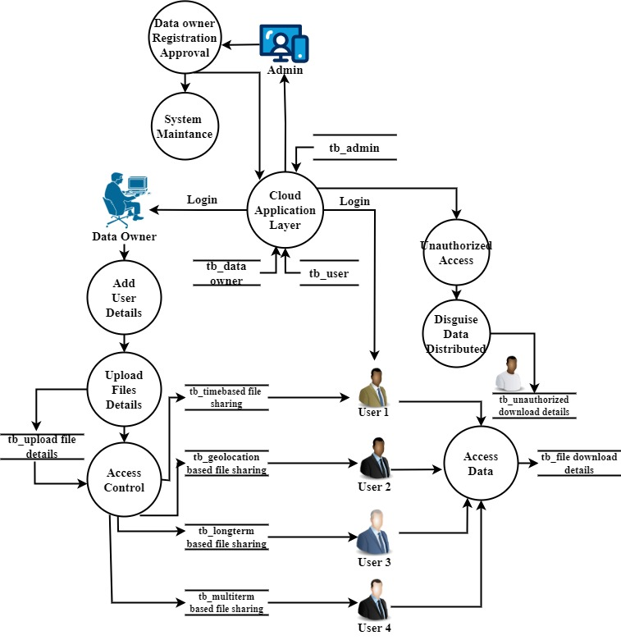
DFD: Level 2

Slide 39
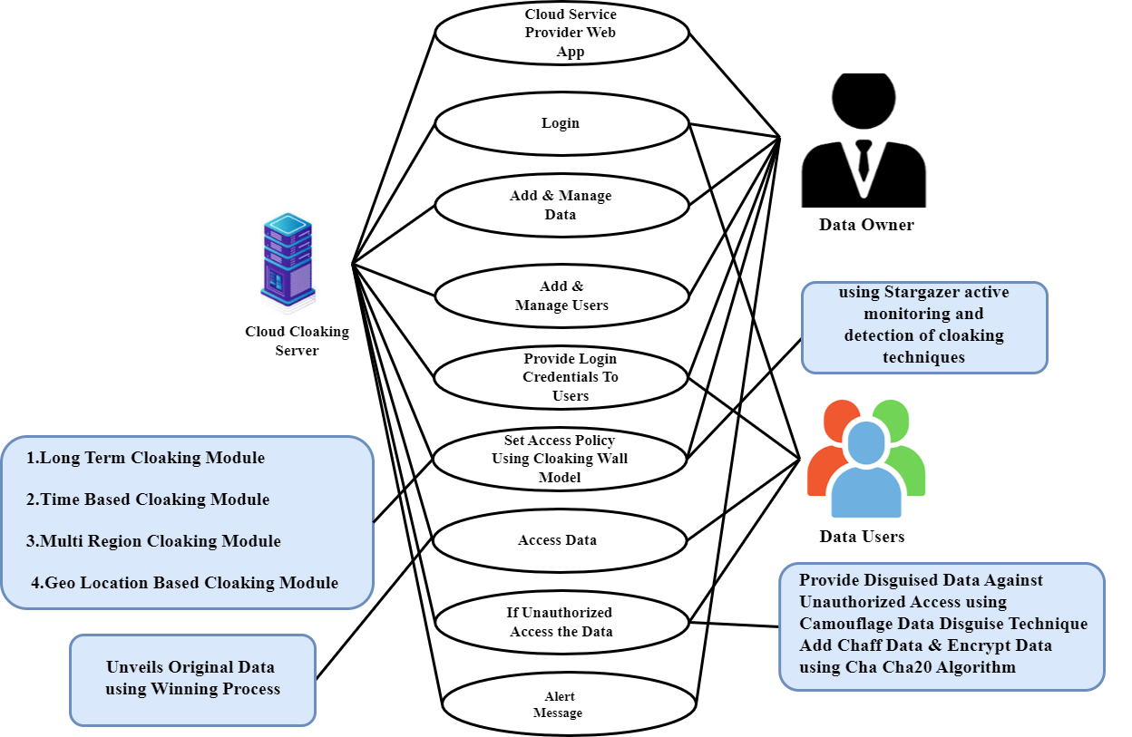
UML: Use Case

Slide 40
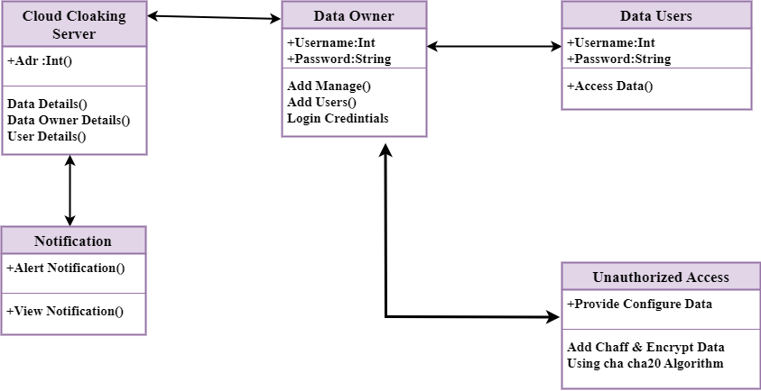
UML: Class

Slide 41
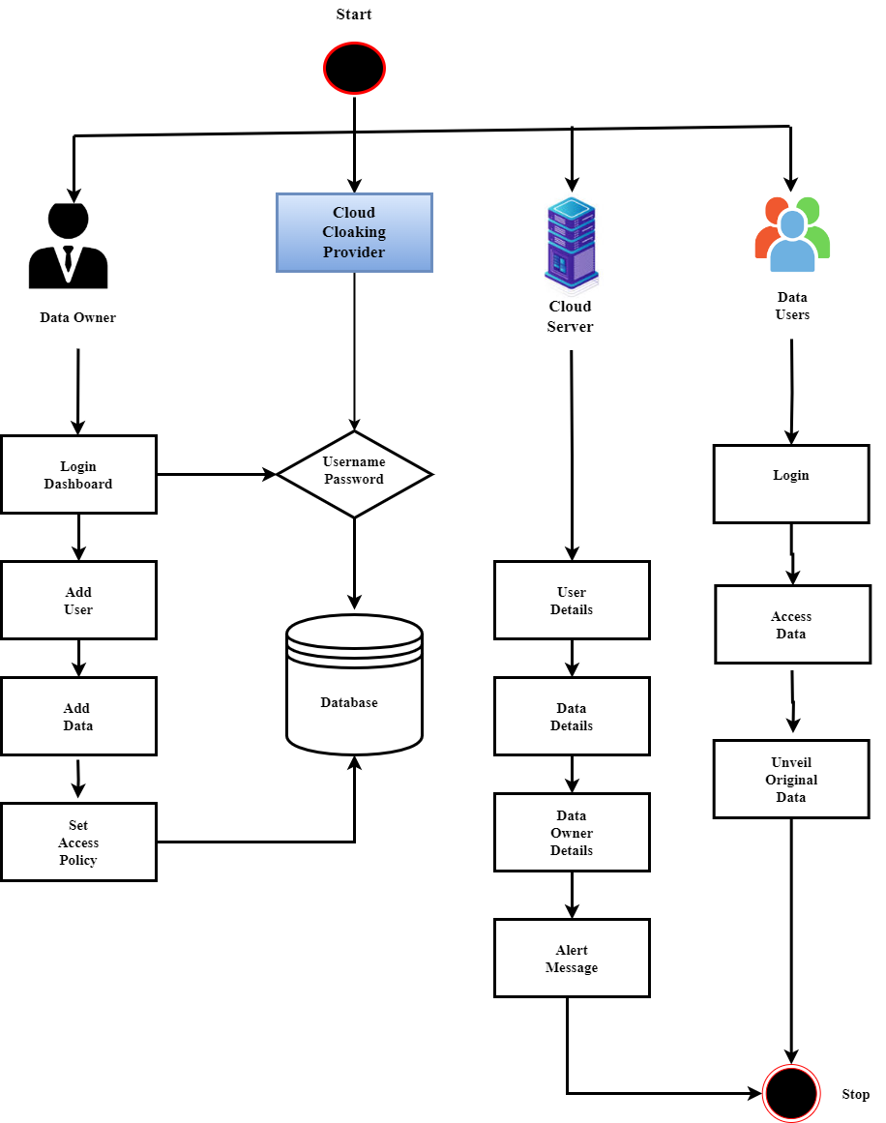
UML: Activity

Slide 42
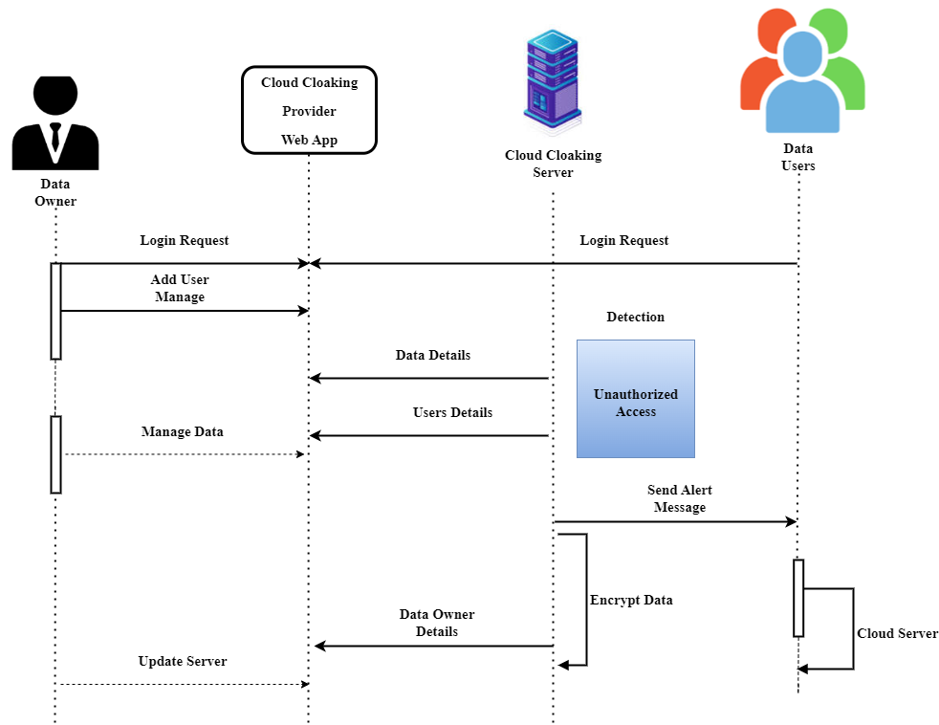
UML: Sequence

Slide 43
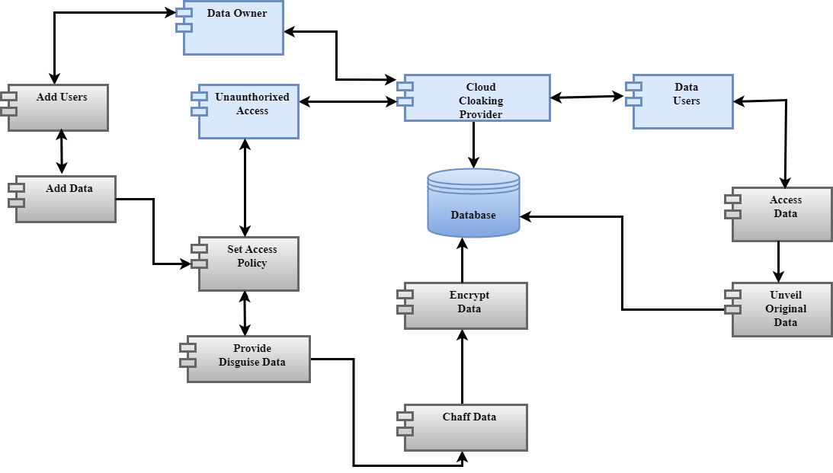
UML: Collaboration

Slide 44
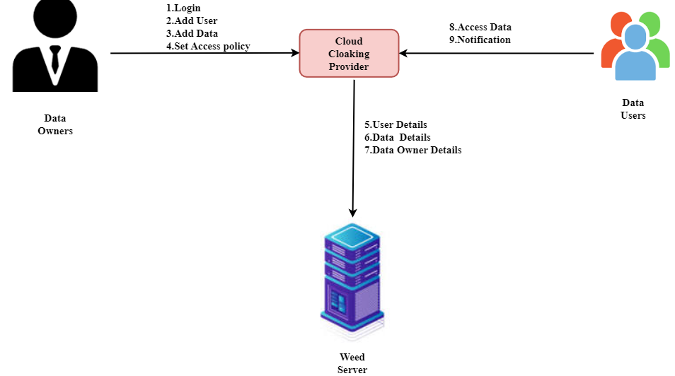
UML: Component

Slide 45
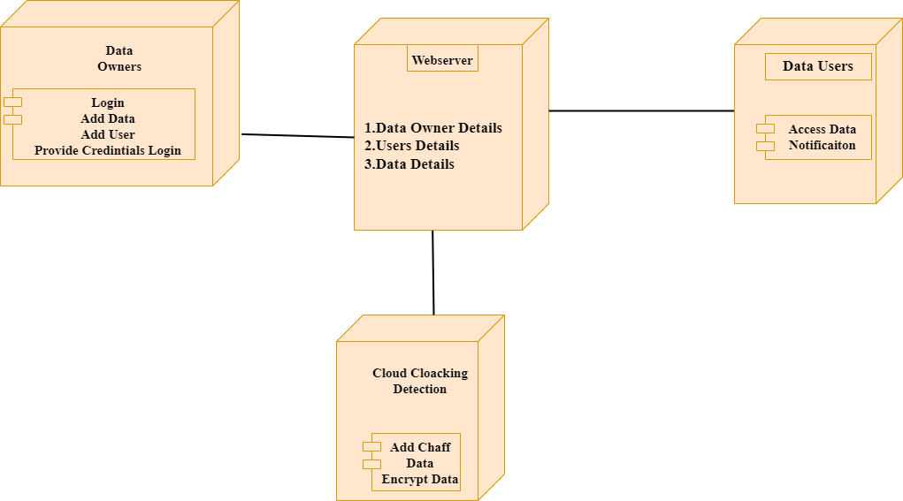
UML: Deployment

Slide 46
ER Diagram

Slide 47
Conclusion
In conclusion, the project introduces a robust solution to enhance data security in cloud computing. The Cloaking Wall Model, with features like Long-Term Cloaking and Geolocation-based Cloaking, ensures persistent confidentiality and global consistency.
The Camouflage Data Disguise technique, integrating Chaffing and Winnowing with ChaCha20 encryption, adds an extra layer of defense. The Cloud Consumer Web App's modular design caters to both administrators and users, offering secure functionalities like user authentication, data management, and monitoring.
The project's testing phase, outlined in the test report, demonstrates a rigorous approach to quality assurance. The innovative Bot Identification Mechanism, coupled with the Disguise Data Generator module, adds an intelligent layer to the security framework.
By accurately identifying potential bot activity and simulating non-compliant data instances, the system actively responds to emerging threats

Slide 48
Future Enhancement
The future evolution of the system holds exciting possibilities, with key areas of focus.
Integrating machine learning algorithms stands out as a potential enhancement, enabling dynamic analysis of access patterns to adeptly respond to evolving security threats. Behavioral analytics is another avenue, offering a nuanced understanding of user behavior to distinguish normal activities from potential risks.
Additionally, exploring blockchain integration is on the horizon, aiming to enhance data integrity and transparency by leveraging the decentralized and tamper-resistant nature of blockchain technology. These enhancements collectively propel the system towards a more adaptive, context-aware, and secure future.

Slide 49
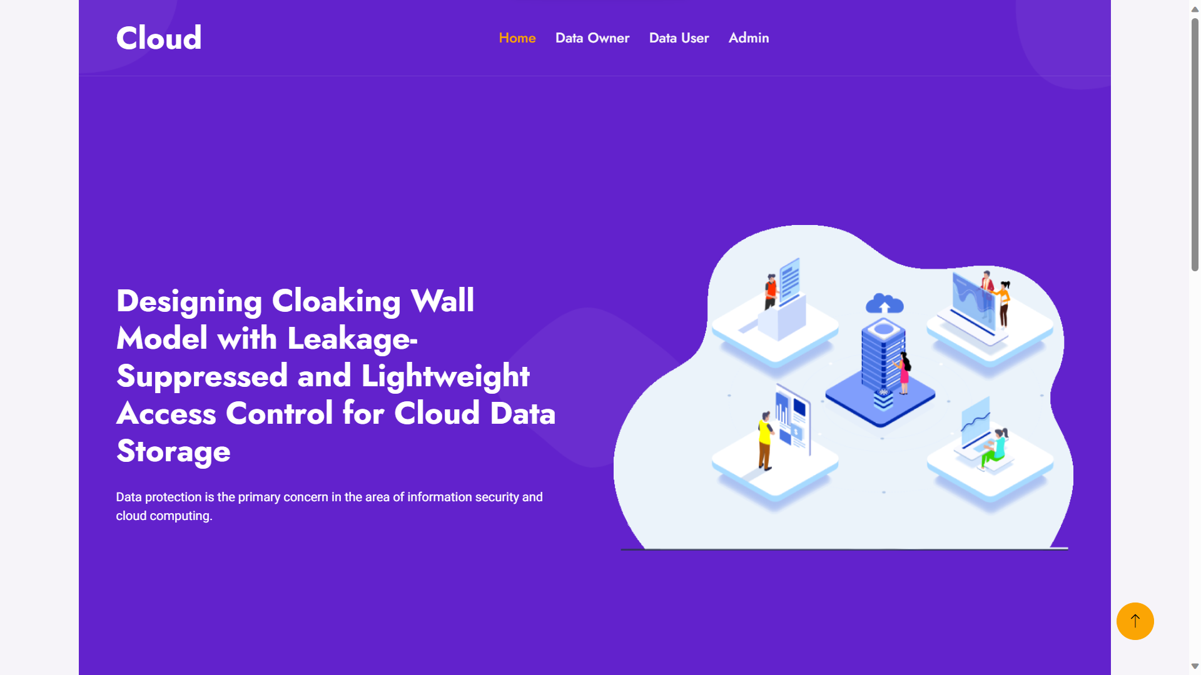
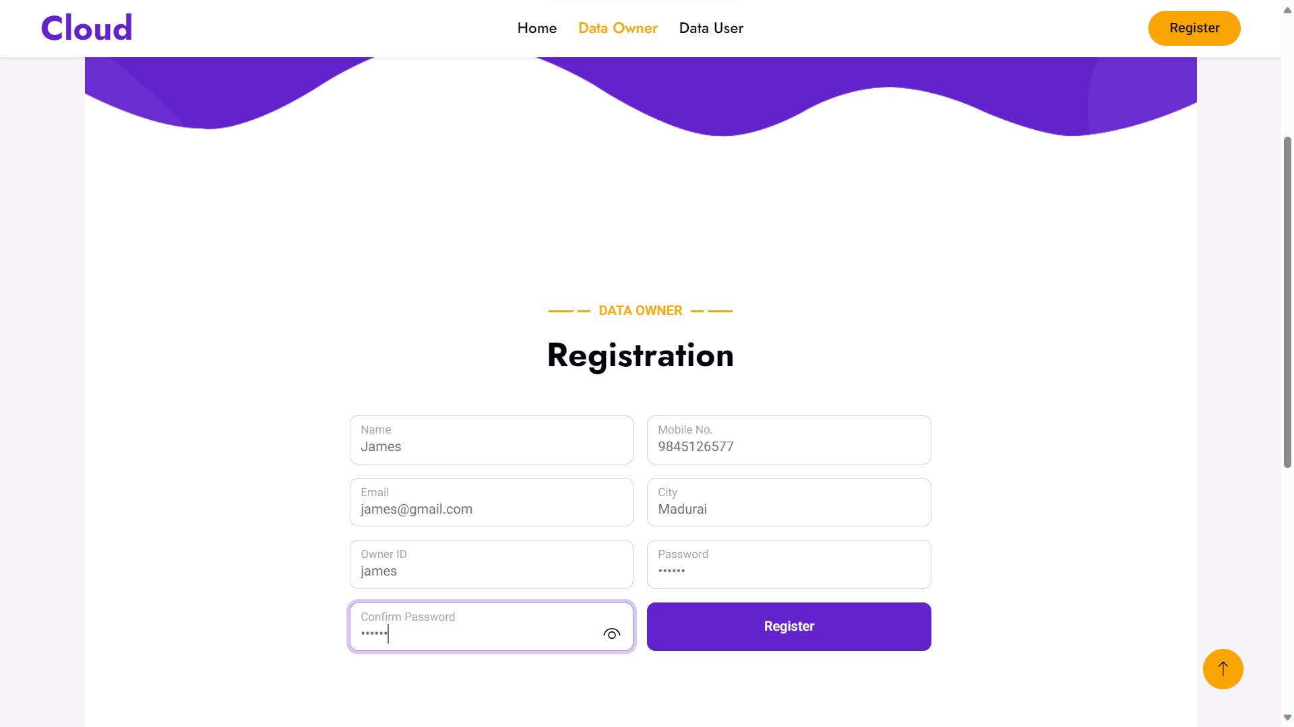
Screenshot

Slide 50
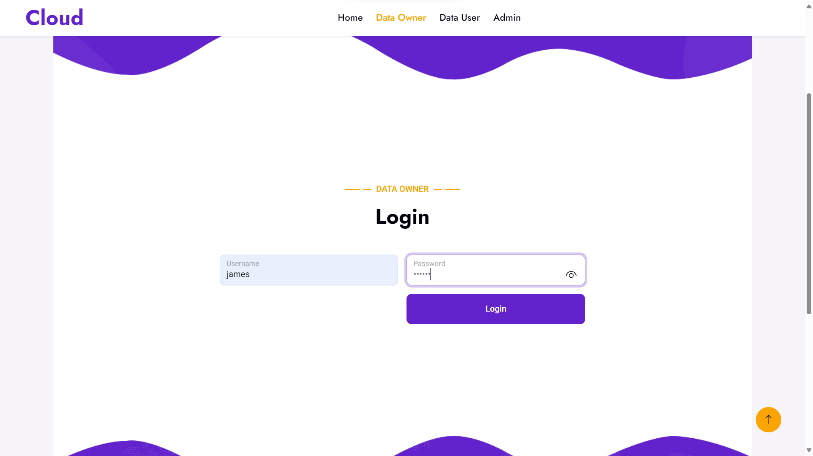
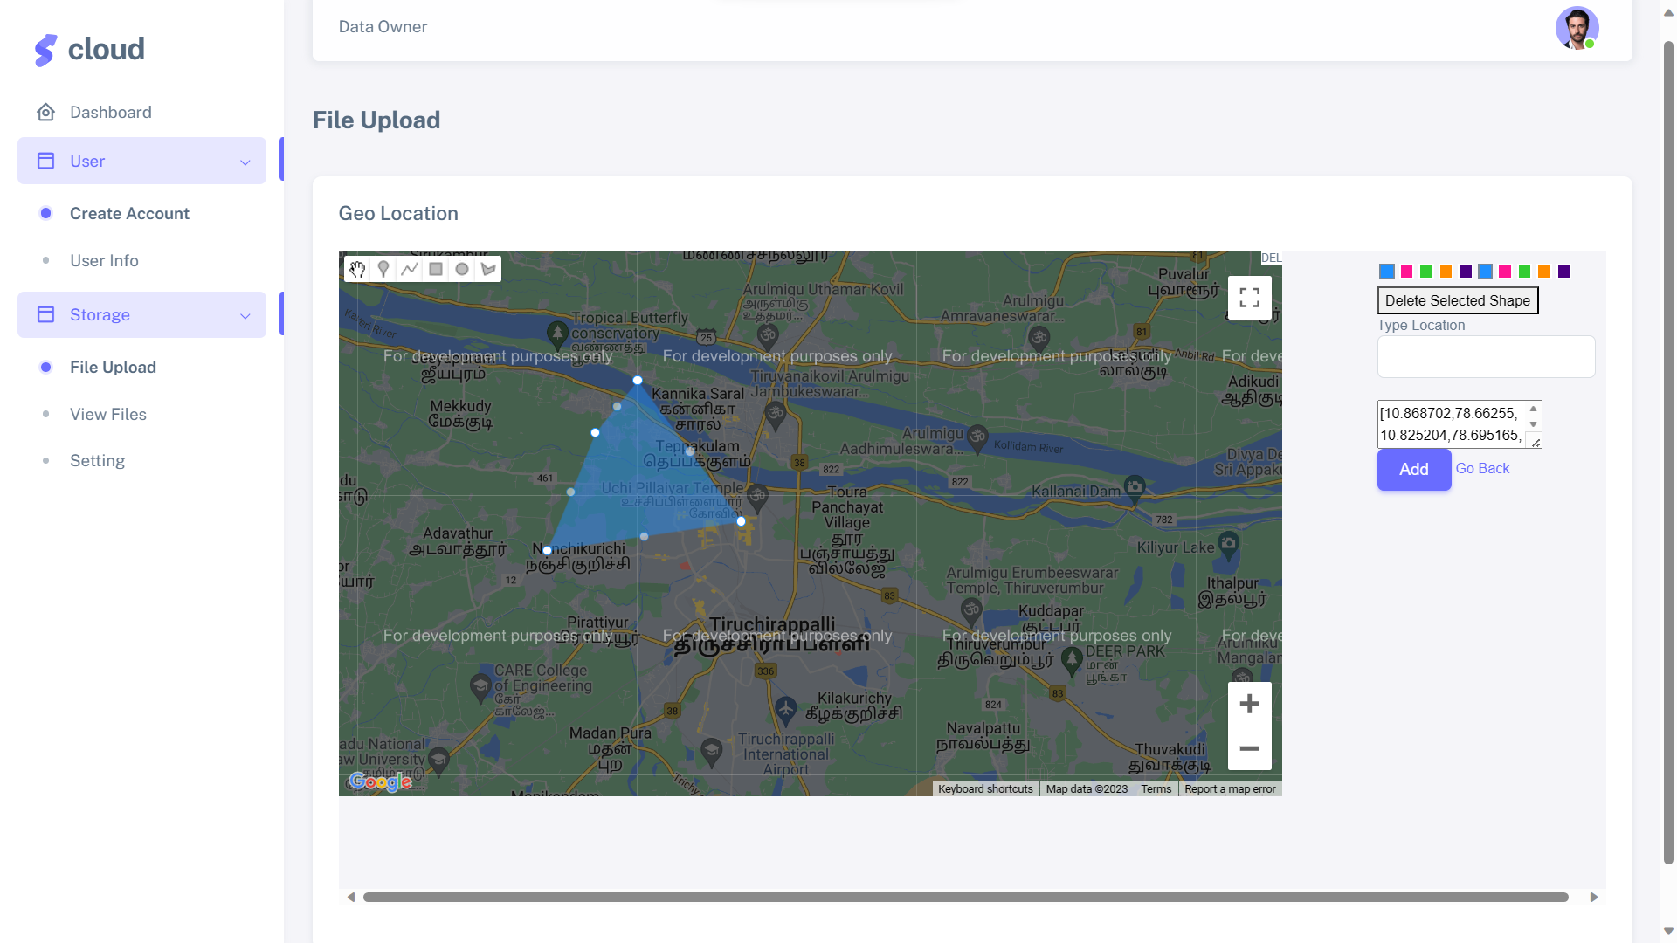
Screenshot

Slide 51
References
E. Alowaisheq, P. Wang, S. Alrwais, X. Liao, X. Wang, T. Alowaisheq, X. Mi, S. Tang, and B. Liu, ‘‘Cracking the wall of confinement: Understanding and analyzing malicious domain take-downs,’’ in Proc. Netw. Distrib. Syst. Secur. Symp., 2019.
G. Zhang, X. Chen, B. Feng, X. Guo, X. Hao, H. Ren, C. Dong, and Y. Zhang, ‘‘BCST-APTS: Blockchain and CP-ABE empowered data supervision, sharing, and privacy protection scheme for secure and trusted agricultural product traceability system,’’ Secur. Commun. Netw., vol. 2022, pp. 1–11, Jan. 2022, doi: 10.1155/2022/2958963.
Y. J. Wang, C. T. Cao, and L. You, ‘‘A novel personal privacy data protection scheme based on blockchain and attribute-based encryption,’’ J. Cryptol. Res., vol. 8, no. 1, pp. 14–27, 2021, doi: 10.13868/j.cnki.jcr. 000416.
E. Zagan and M. Danubianu, ‘‘ADLS Gen 2 for web server log data analysis,’’ in Proc. Int. Conf. Develop. Appl. Syst. (DAS), Suceava, Romania, 2022, pp. 161–166, doi: 10.1109/DAS54948.2022.9786071.
P. Zeng, Z. Zhang, R. Lu, and K.-K.-R. Choo, ‘‘Efficient policy-hiding and large universe attribute-based encryption with public traceability for Internet of Medical Things,’’ IEEE Internet Things J., vol. 8, no. 13, pp. 10963–10972, Jul. 2021.

